Slide 1
Machine learning to predict OleA temperature preferences
Goal: Identify sequence signatures of OleA temperature preference
Dataset: combination of 30 TARA sequences, 73 OleAs from previous studies, and 20 interesting psychrophiles and thermophiles
Prediction: optimal growth temperatures (from literature)
Predictors: OleA sequence features

Slide 2
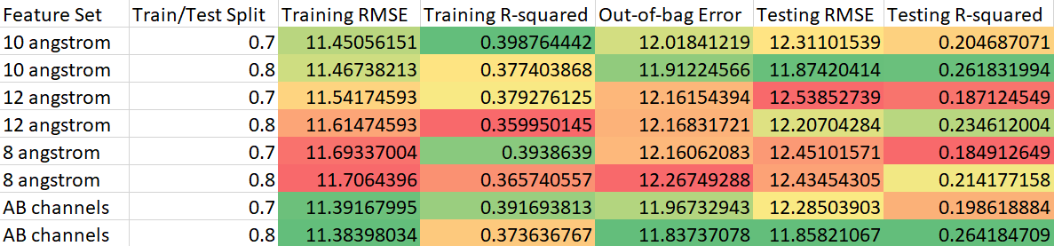
Regression
Which feature set gives the best prediction?

Slide 3
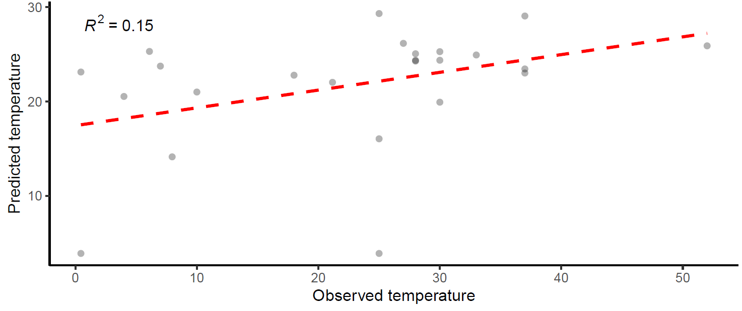
Example prediction plot

Slide 4
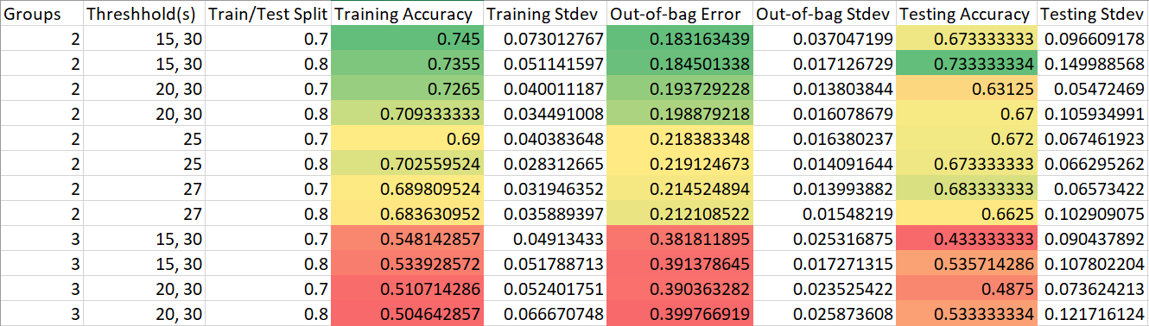
Categorical
Which threshold gives the best prediction?
*

Slide 5
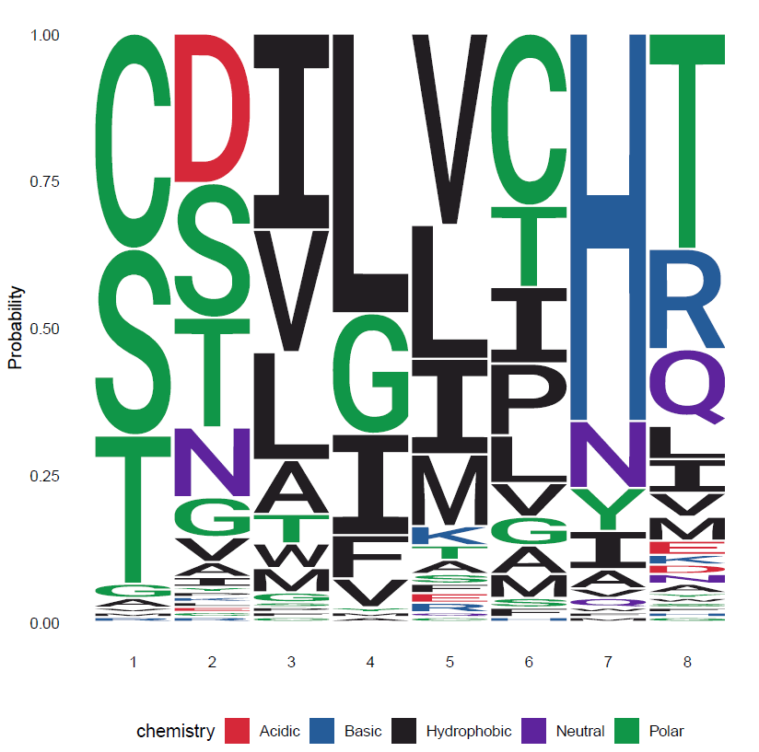
Which residues?
In Xanthomonas campestris:
112S
172T
176V
203L
258I
284I
291H
292T

Slide 6
Next steps
Possibly use mutant library for experiments
Test thermostability/activity at various temperatures
What else?

